Slide 1

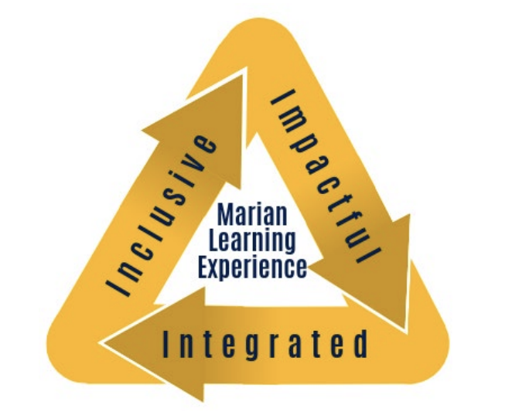
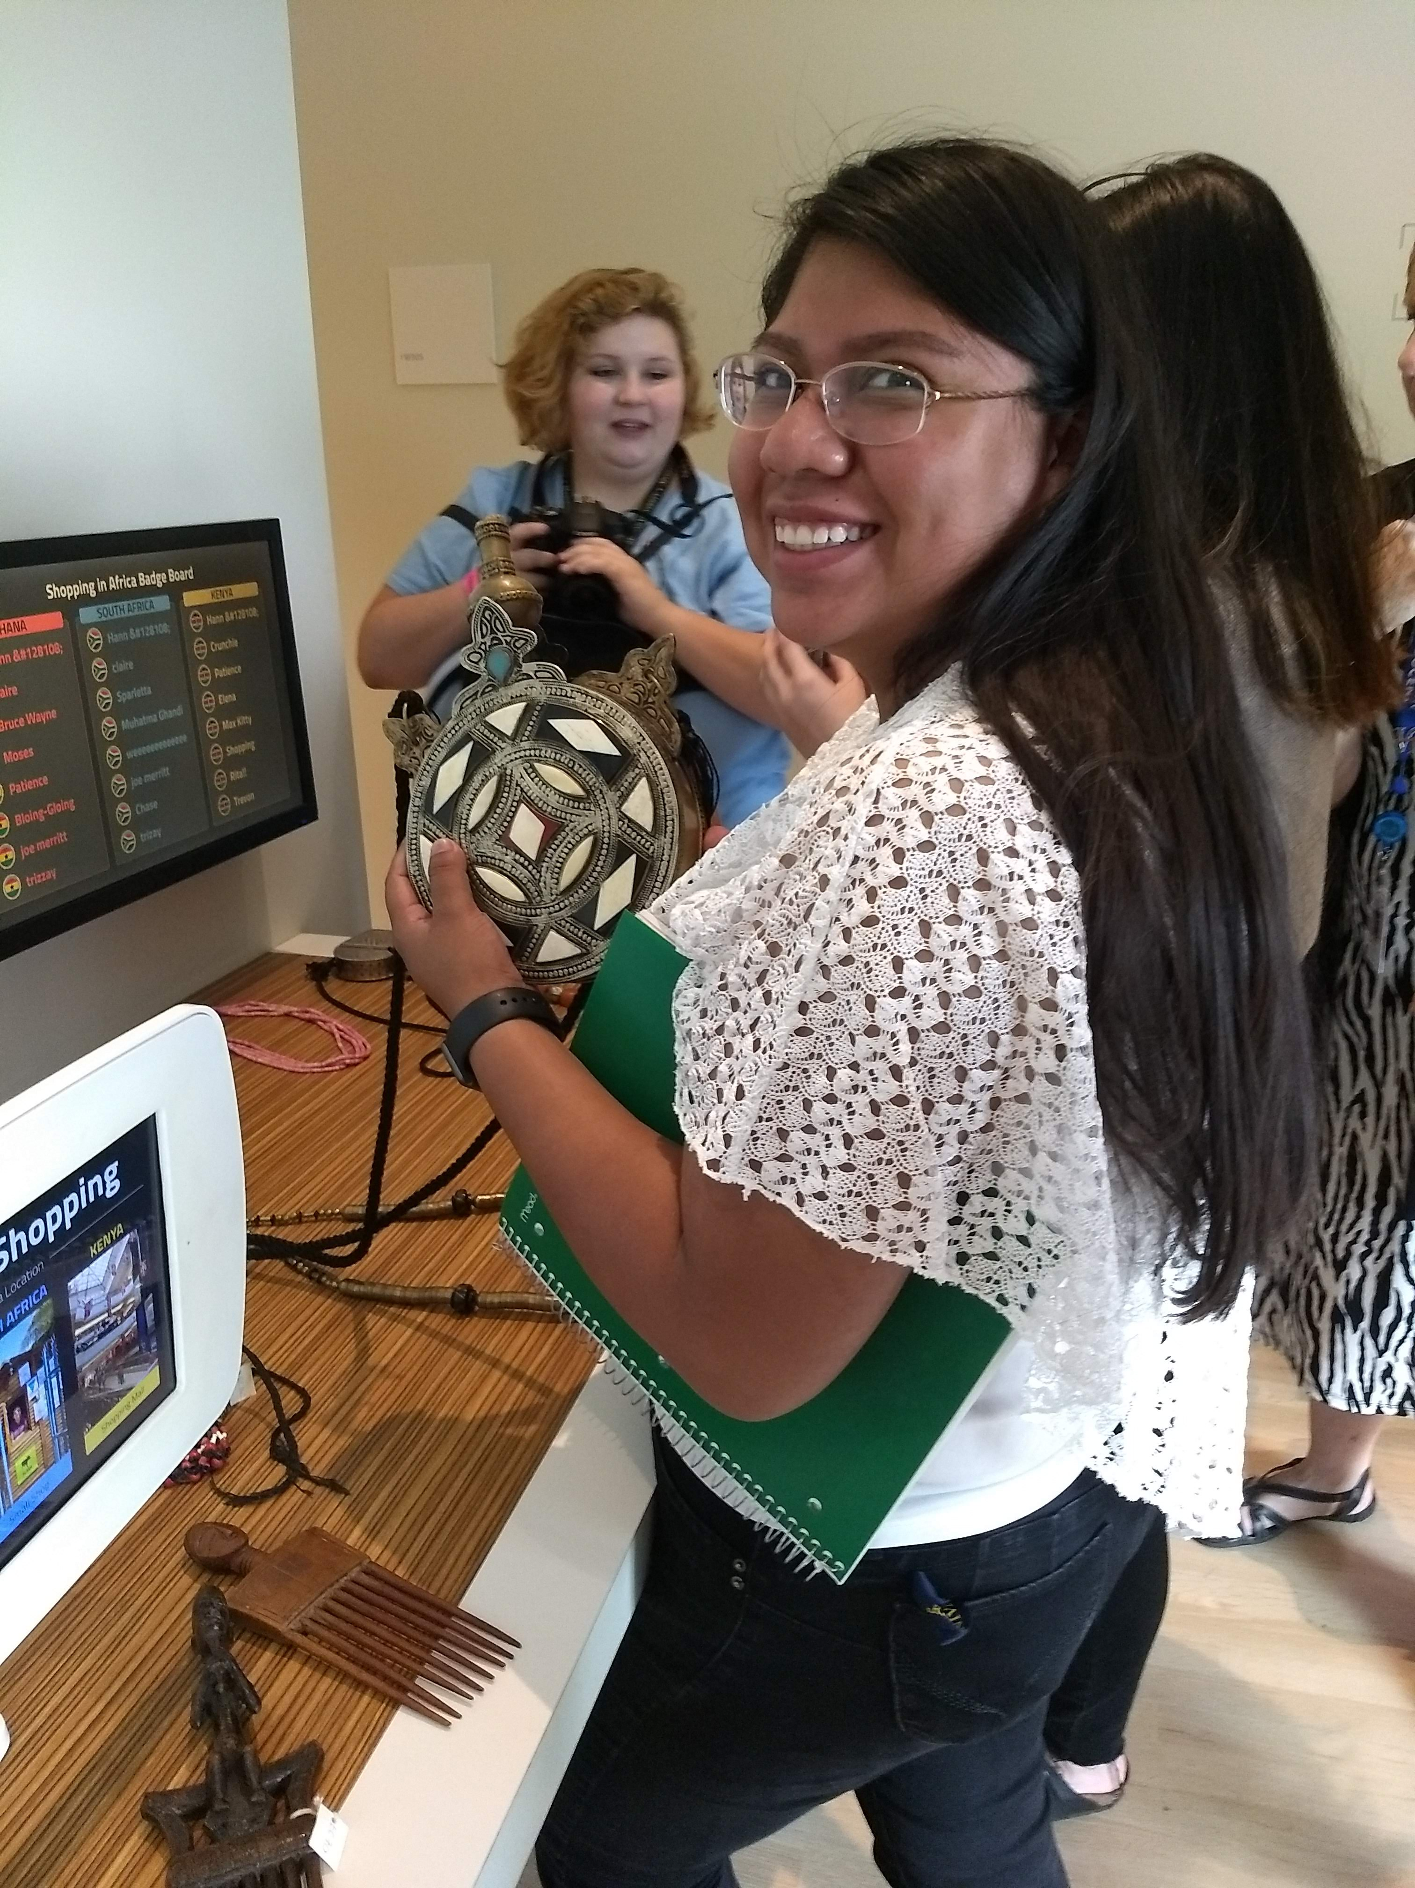
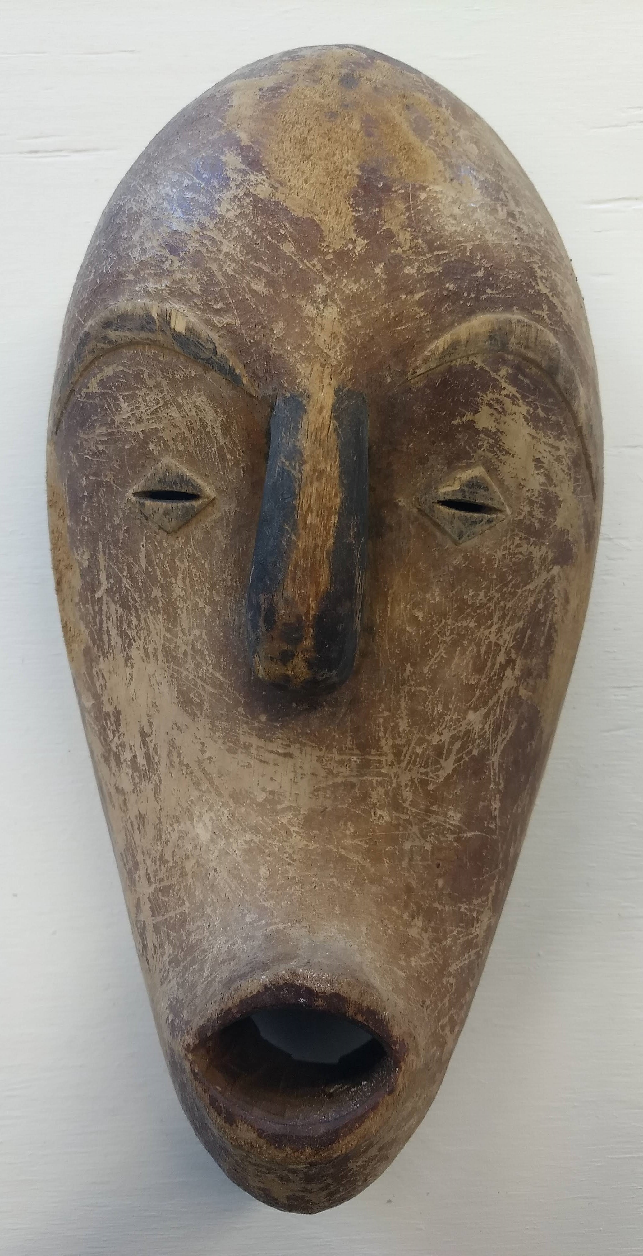
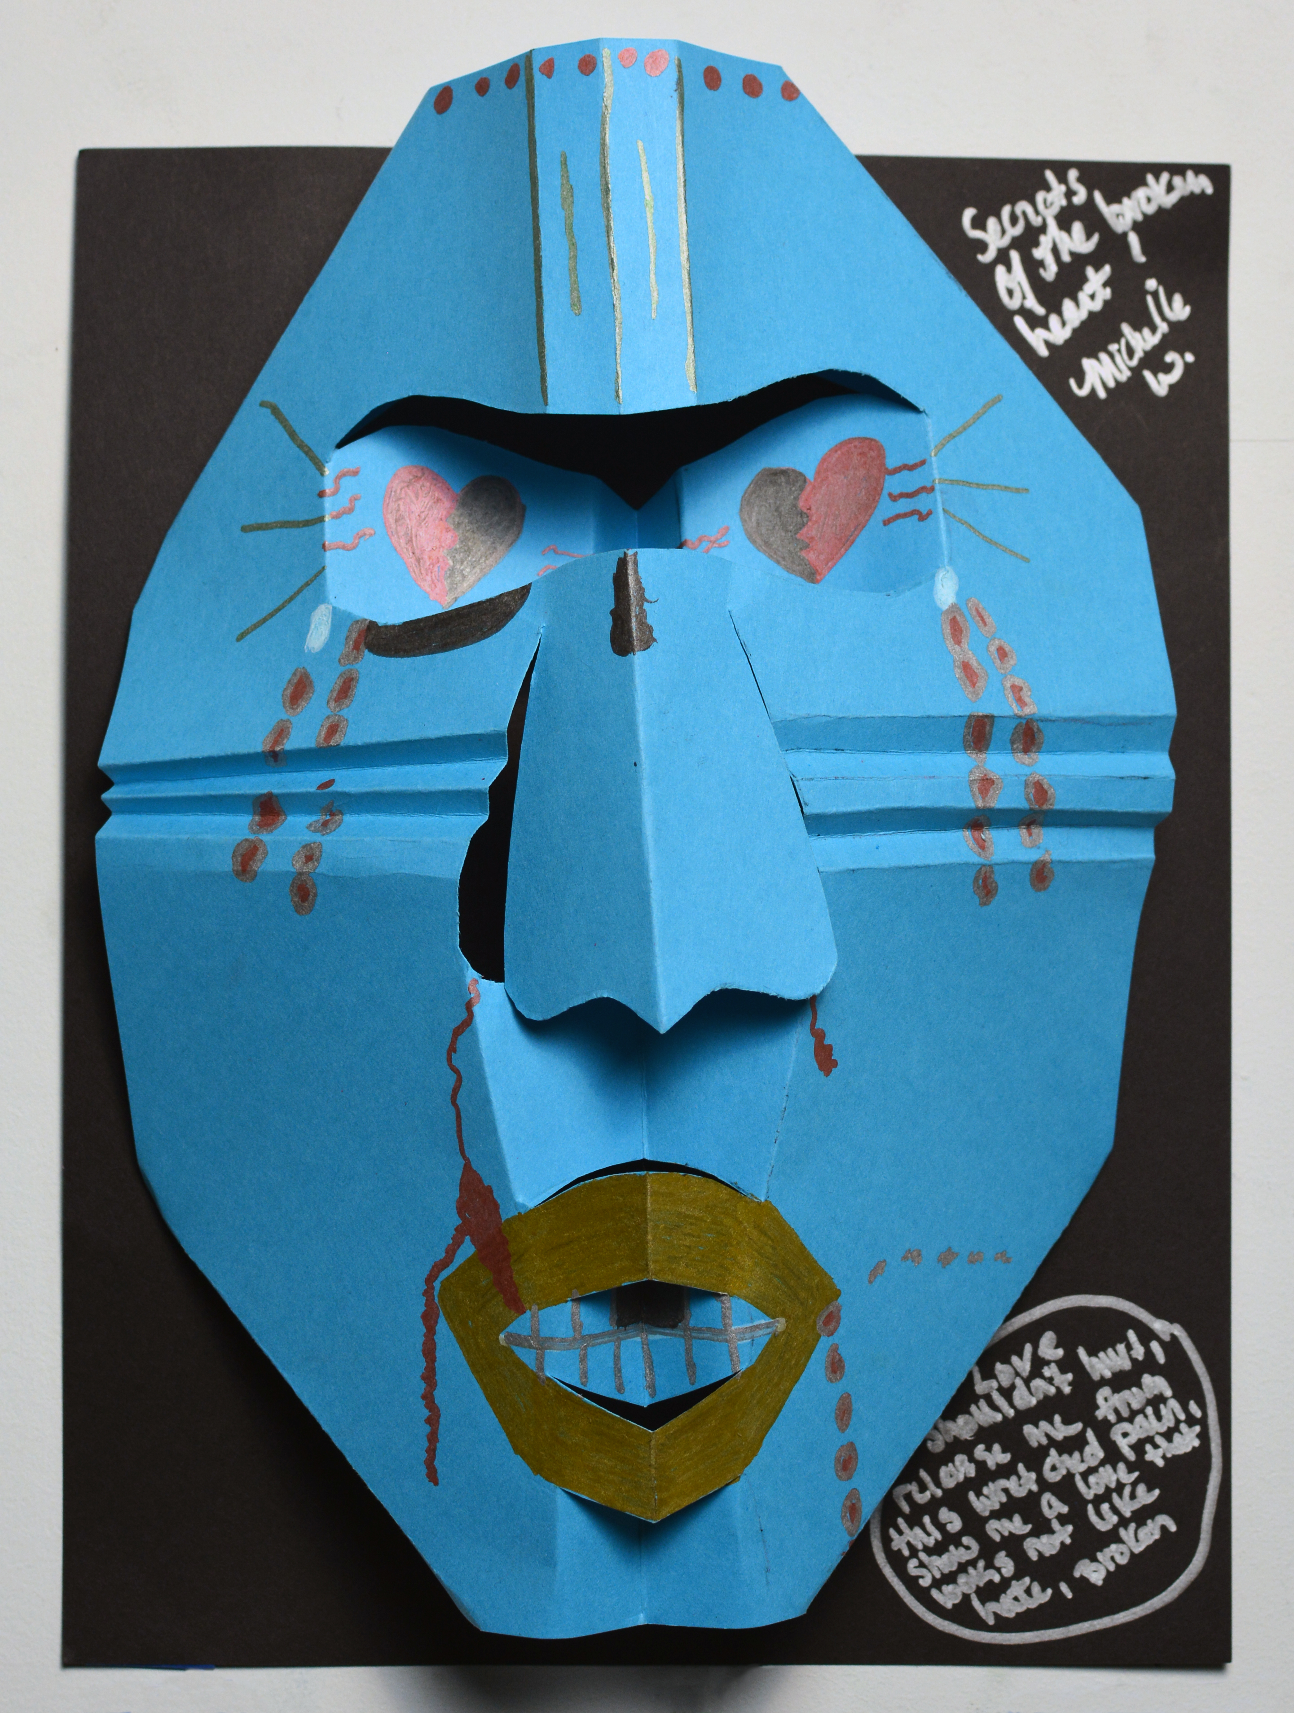
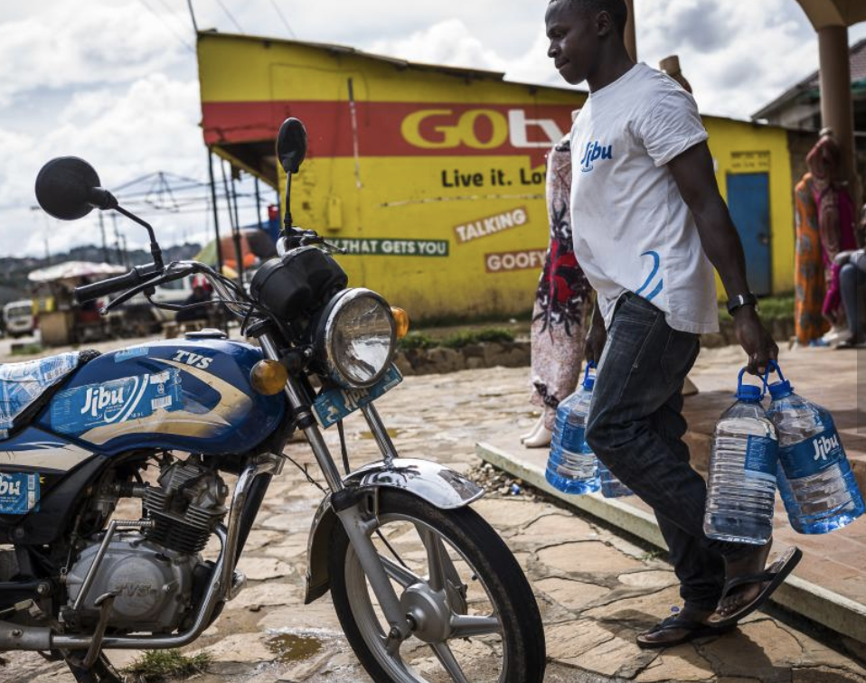
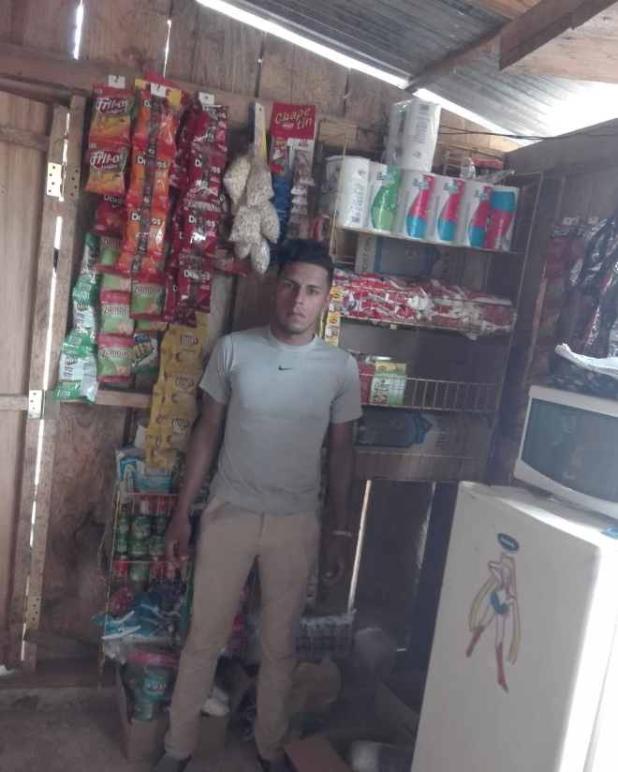
FYS ‘On Campus and Behind Bars’
Department: First Year Seminar
Instructors: Jenny Ambroise/ Holly Gastineau-Grimes
Seeing, Thinking, Wondering
KIVA - My Material World
Premise: Through his exploration of the global garment industry, author Kelsey Timmerman learns about the different cultures that he visits. In “Seeing, Thinking, Wondering” students reflect on three prompts to deepen their understanding of specific African cultures.
Inclusive: Students took a tour of Newfield’s African Collection. While on the tour, each student selected one object and wrote notes on the following prompts: What do you see? What do you think about that? What does it make you wonder? They then shared their discoveries when they returned to the classroom. Reflecting individually and having time to process before sharing with the class encouraged participation from all students. Students were challenged to strengthen their understanding of seemingly different cultures from their own through careful observation, interpretation, and further research and discussion.
Integrated: This strategy encouraged students to explore their personal interests by selecting objects that stood out to them in the collection, and this strategy could be applied to research in multiple disciplines. By visiting the museum, students integrated campus curriculum with learning in the broader Indianapolis community.
Impactful: This exercise helps set the stage for practicing primary source research, developing keen observational skills, and eliciting curiosity.
Behind Bars:
At the Indiana Women’s Prison, 2 key changes were made:
African Art: Rather than visit the museum, students studied two authentic African masks for the “Seeing, Thinking, Wondering” prompt.
Student Art: Students made their own versions of masks using a pop-up technique with paper, which served to integrate students’ own life experiences with the exercise.
“I was inspired by the elegance of the Yaure and the symbolic nature of the masks. I love the representation of something being put to death and new life being gleaned from the pieces left behind. The secrets of the broken heart is the death of the violence and hate that was called love in my life.”
(student quote / mask pictured in upper right)
Premise: Kelsey Timmerman considers the global garment industry as one model to encourage economic development across countries. In ‘KIVA – My Materia World’ students explore other examples, such as entrepreneurship and education.
Inclusive: After reading Parts I and II of Where Am I Wearing, students were invited to reflect on their own clothing choices and then take a global ‘map’ tour with the following prompts: What favorite/special shirt or item did you wear to class today? Explain what it looks like and why you chose to share this item. Check the tag – where is it from? Can you find the country on the map? What would you like to learn about this country?
Integrated: This strategy allowed for students to blend their personal interests with others around the world. KIVA is a platform that allows individuals to help others through crowdfunding and micro-loans (these are small loans to help those who can’t access traditional banking). Students worked with partners to explore the site and proposals. This form of research strengthens intellectual curiosity across majors.
Impactful: Students voted on ‘one’ loan proposal for the class to fund. This exercise required students to showcase their research, observational, and communication skills as each pair of students were tasked with explaining why the class should fund their selected proposal. This project both hones student skills and gives them an opportunity to help their global community.
Behind Bars:
At the Indiana Women’s Prison, 2 key changes were made:
Technology: Selected projects were pulled from the kiva site and shared with students as a hard copy packet. Students still paired together to explore and select a project to fund.
Student Prompt: The women all have the same clothing – a few tags can be found on shoes, etc., Students were asked to circle back in their thinking about the project and reflect on the following prompt: KIVA also operates in the United States. Imagine that you have the opportunity to craft a proposal for either yourself, a friend, or a fellow student who has sought your expertise. What might you propose for a loan?
One student proposed a loan to kick-start a dog foster and training program, pulling on her expertise gained from working with the Indiana Canine Assistant Network at the Indiana Women’s Prison.
FIRST YEAR SEMINAR
The First Year Seminar lays out ‘Communication Fluency’ as one of the General Education Outcomes. Each individual class crafts their own assignments to achieve this objective. We spotlight two example assignments that both foster communication fluency, one inspired by the fine arts that explores African Art and a second from the social sciences that explores global development projects. Additionally, we show how to replicate these two assignments with a few personal modifications for classes beyond the traditional campus, at the Indiana Women’s Prison.
Course Objective: Communication Fluency – Demonstrate critical and creative strategies for generating and sharing meaning
Name experiences and concepts with insightful and appropriate specificity
Support claims with specific evidence, data, and illustrations as appropriate to writing assignments

